Slide 1



fullstackdatascience.com
Lesson 16 - Git & DBT
Software Engineer
Created by Huydata
DA K6
Lesson 3
huynt@fullstackdatascience.com
1

Slide 2

Learn
About
01/
Git Installation
02/
Git New Project
03/
DBT
fullstackdatascience.com
2

Slide 3

GIT
Installation
Git is a free and open source distributed version control system. Git can track changes in source code for developers to work together.
Github is a cloud hosting service that evolved from Git.
3

Slide 4
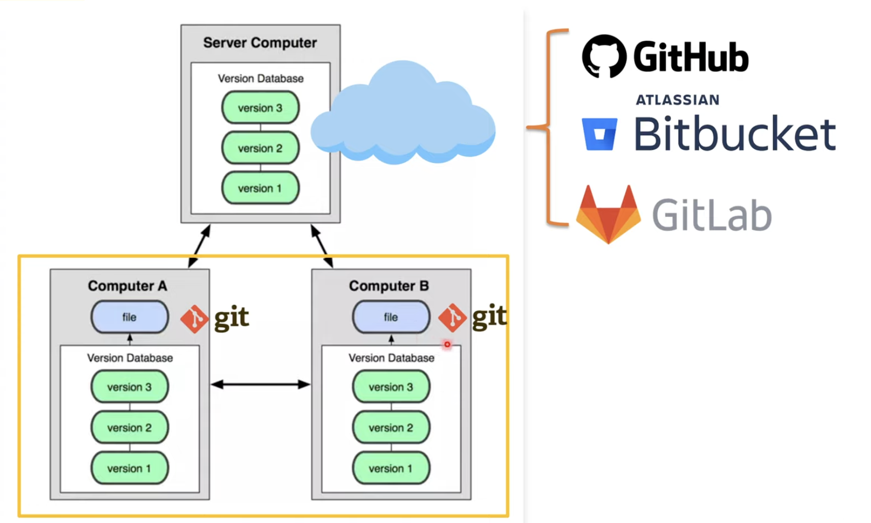
Git and GitHub Example
5

Slide 5
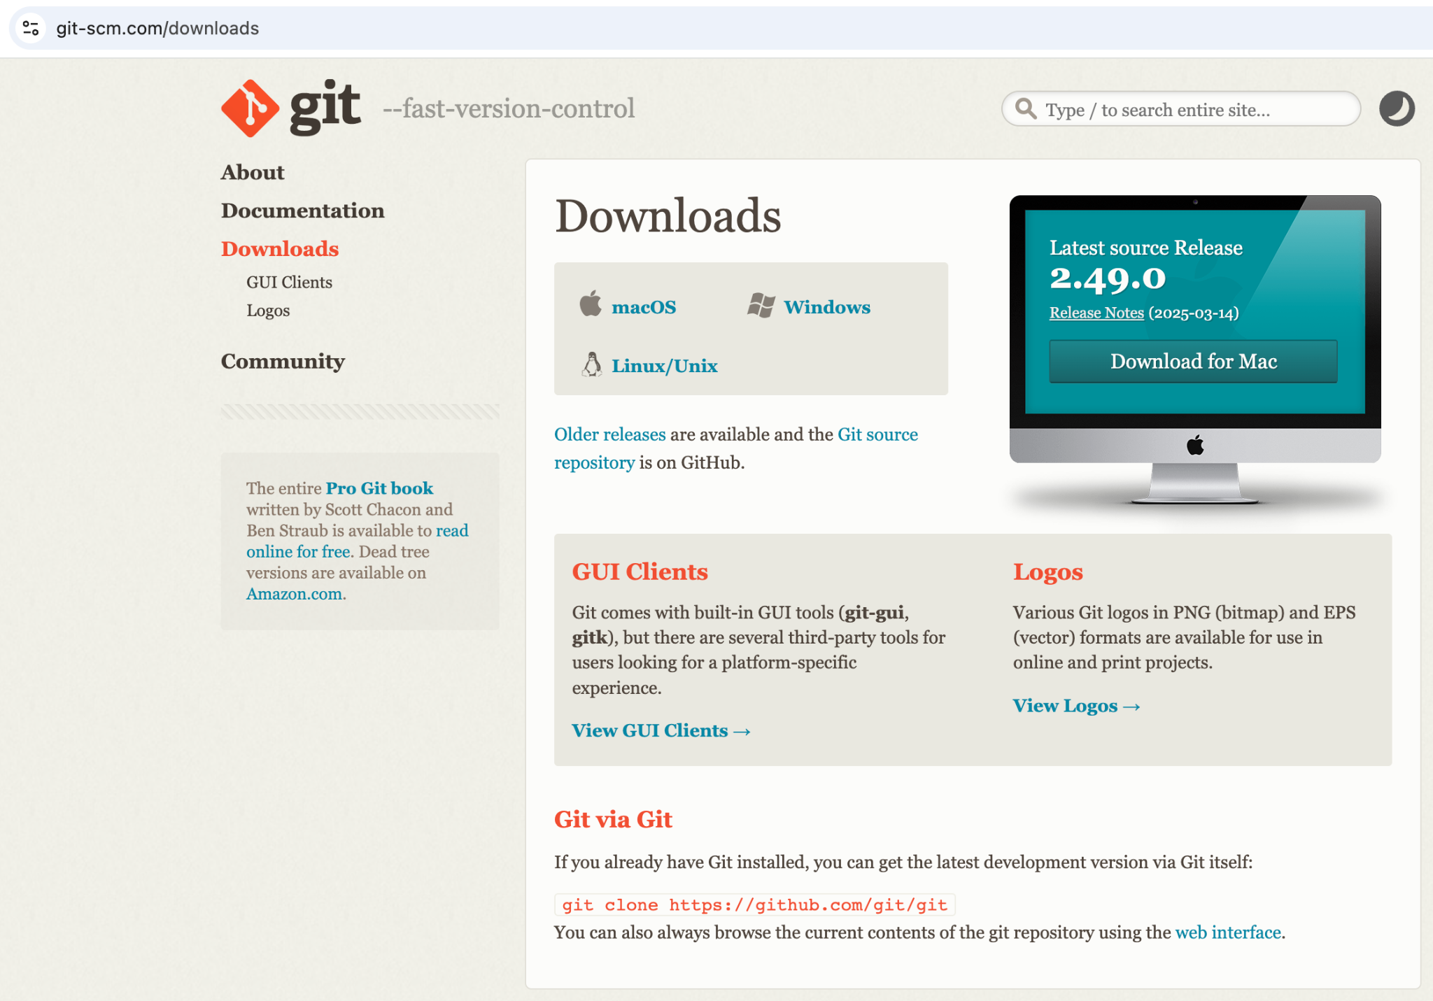
Git and GitHub Installation Guide
1. Download install File
5

Slide 6
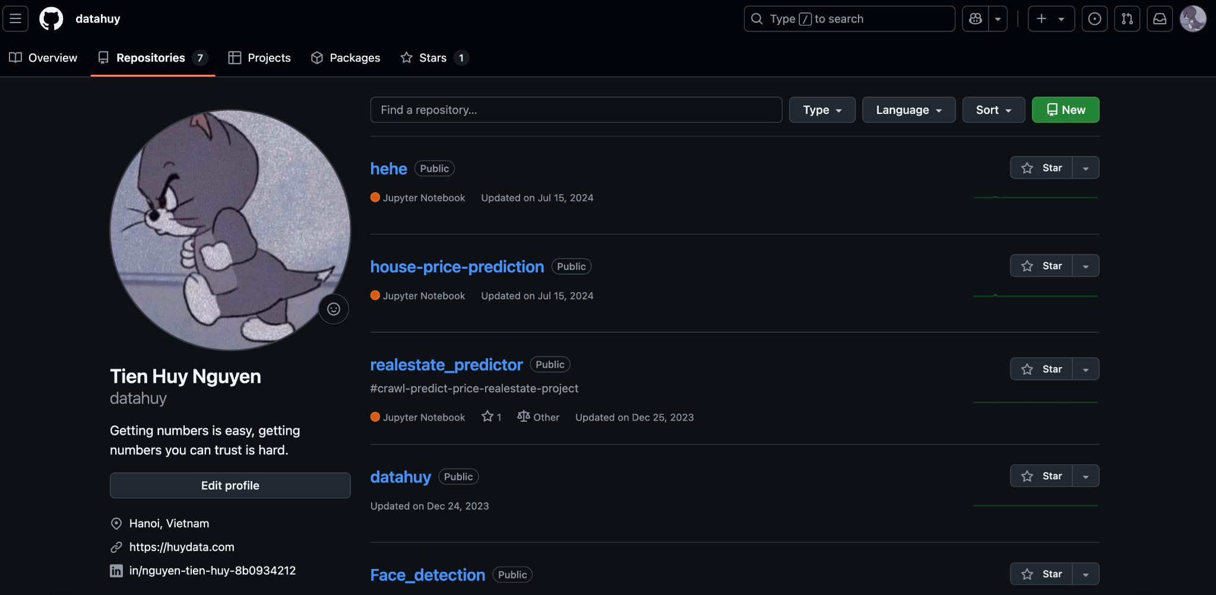
Git and GitHub Installation Guide
2. Connect Git and Github
5

Slide 7
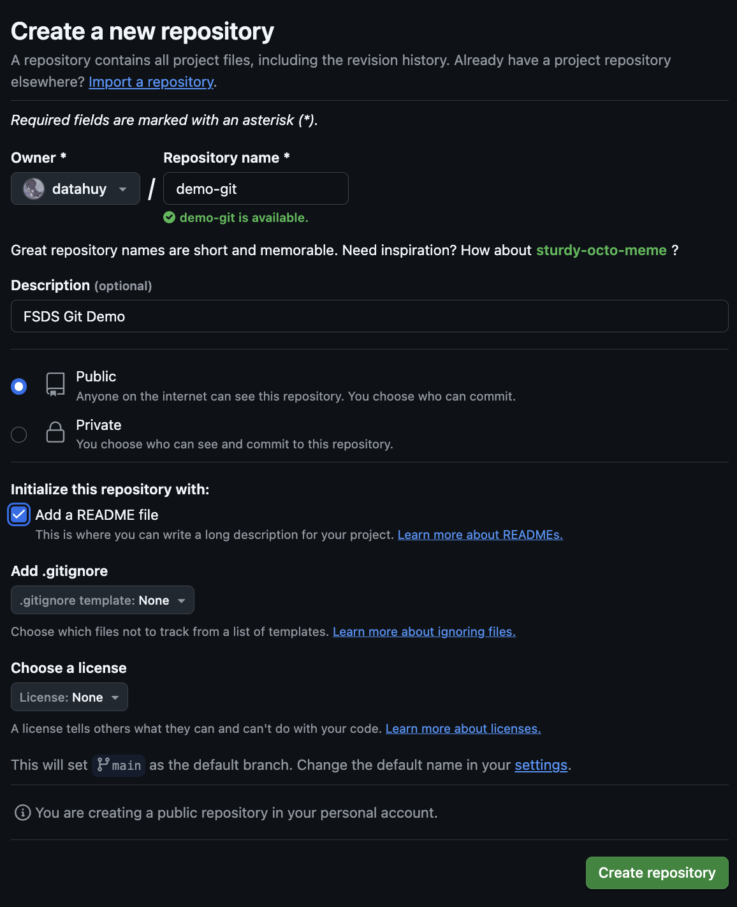
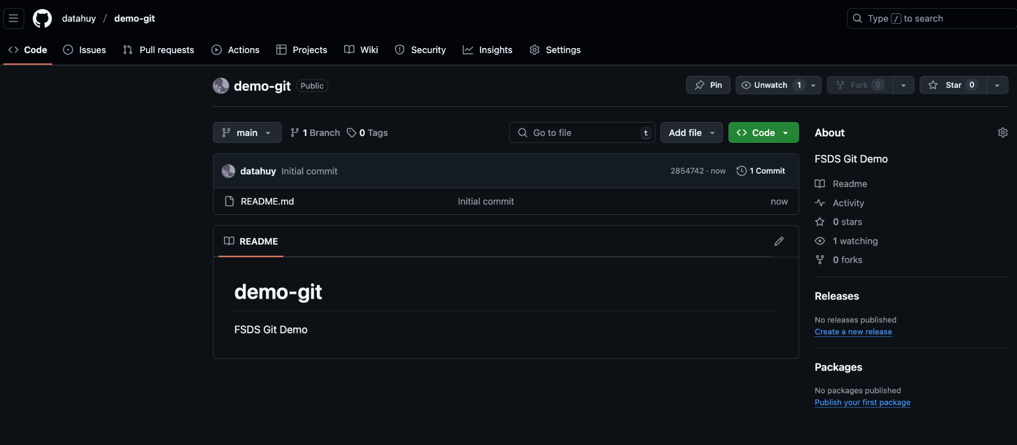
Git and GitHub Installation Guide
2. Connect Git and Github
5

Slide 8
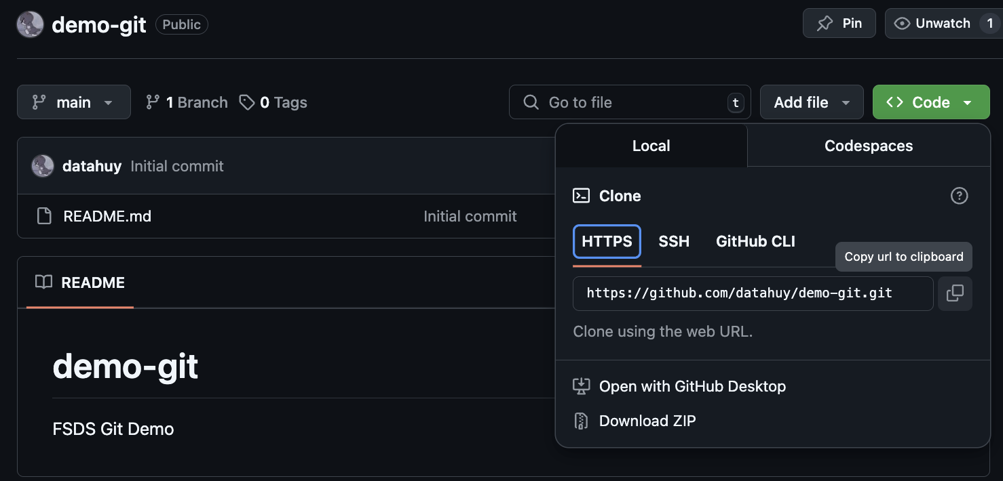
Git and GitHub Installation Guide
3. Clone remote repo to local repo
5

Slide 9
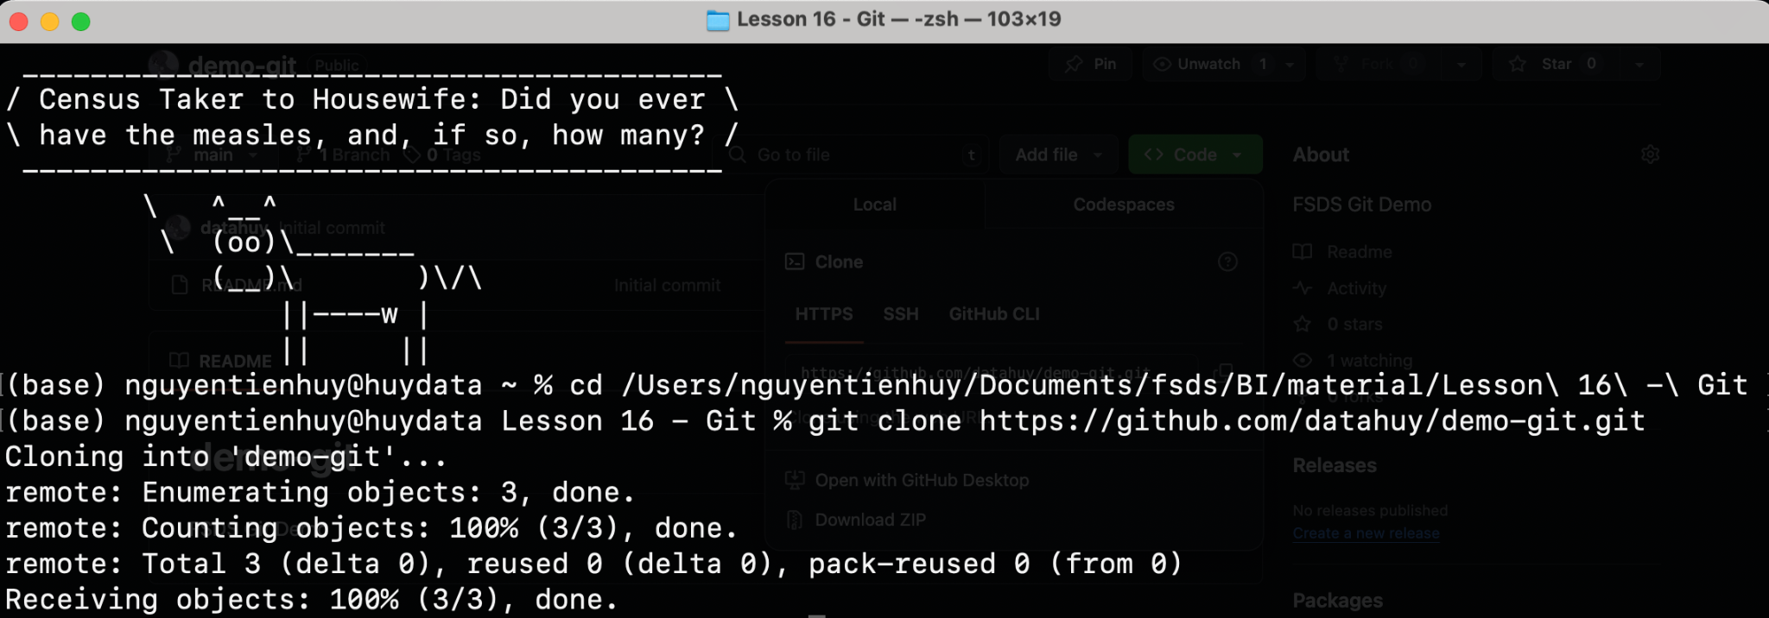
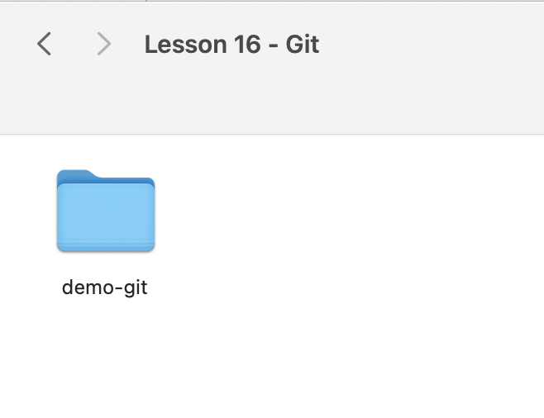
Git and GitHub Installation Guide
3. Clone remote repo to local
5

Slide 10
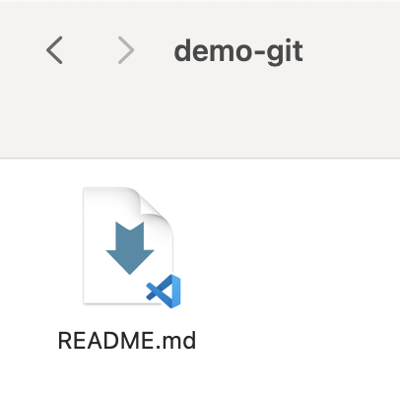
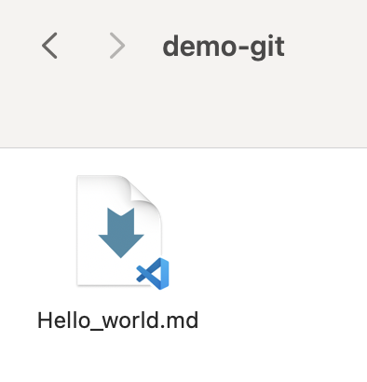
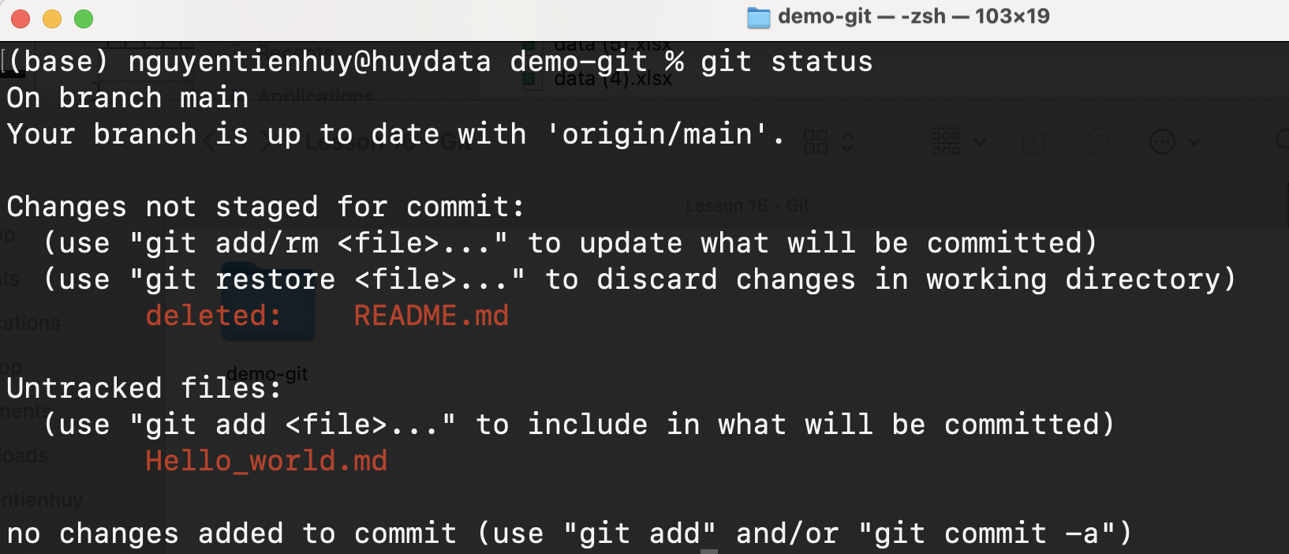
Git and GitHub Installation Guide
4. Edit File Name
There are 2 changes:
5

Slide 11
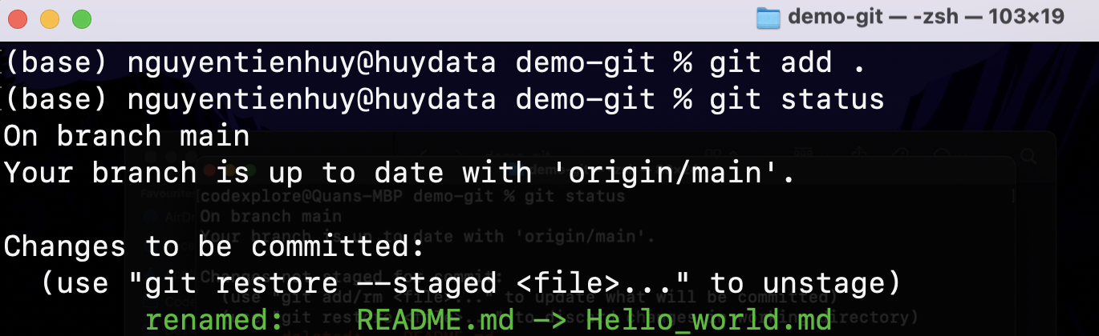
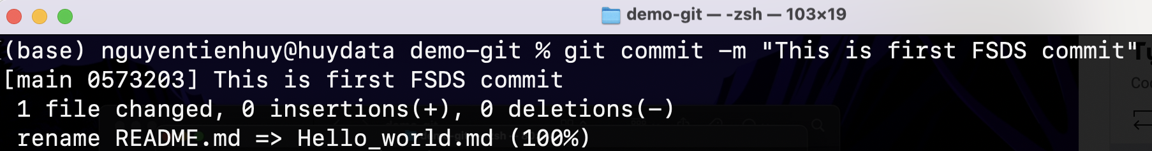
Git and GitHub Installation Guide
5. Add changes to Staging Area
5

Slide 12
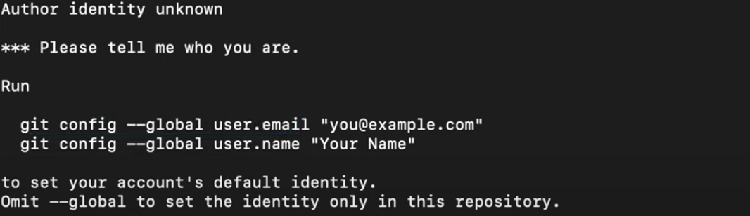
Git and GitHub Installation Guide
6. Error because email is not filled in
5

Slide 13
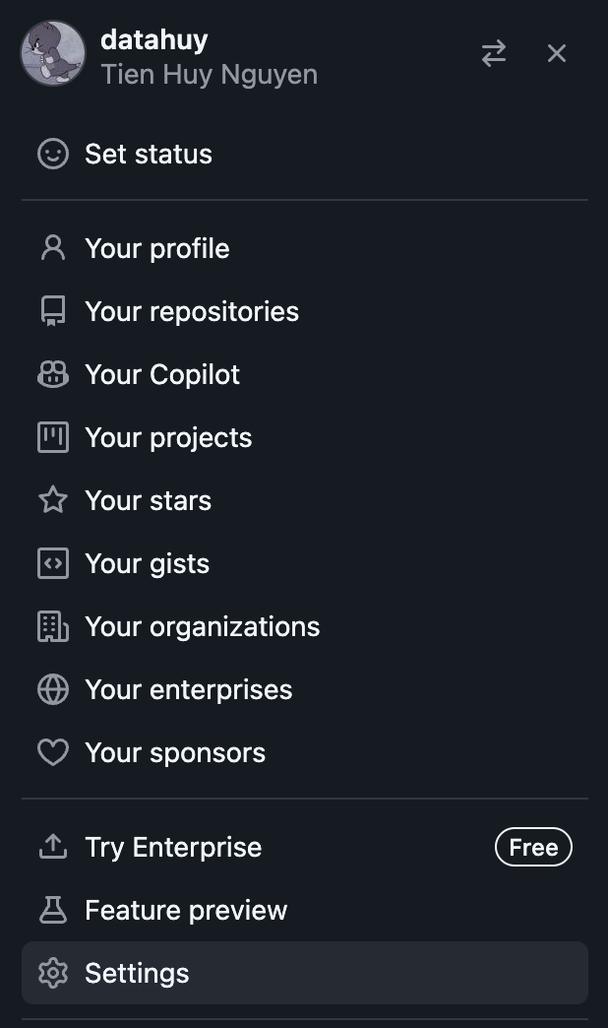
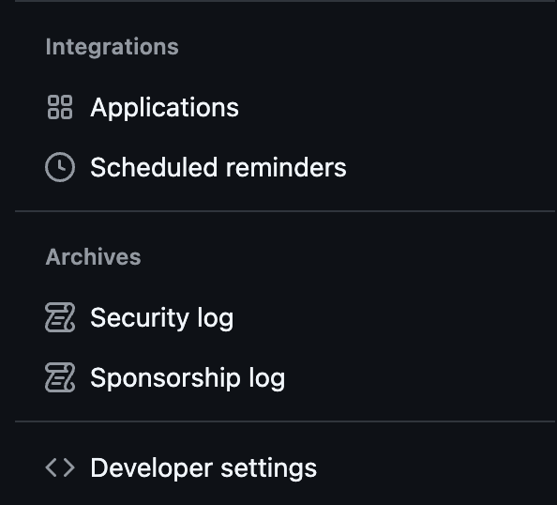
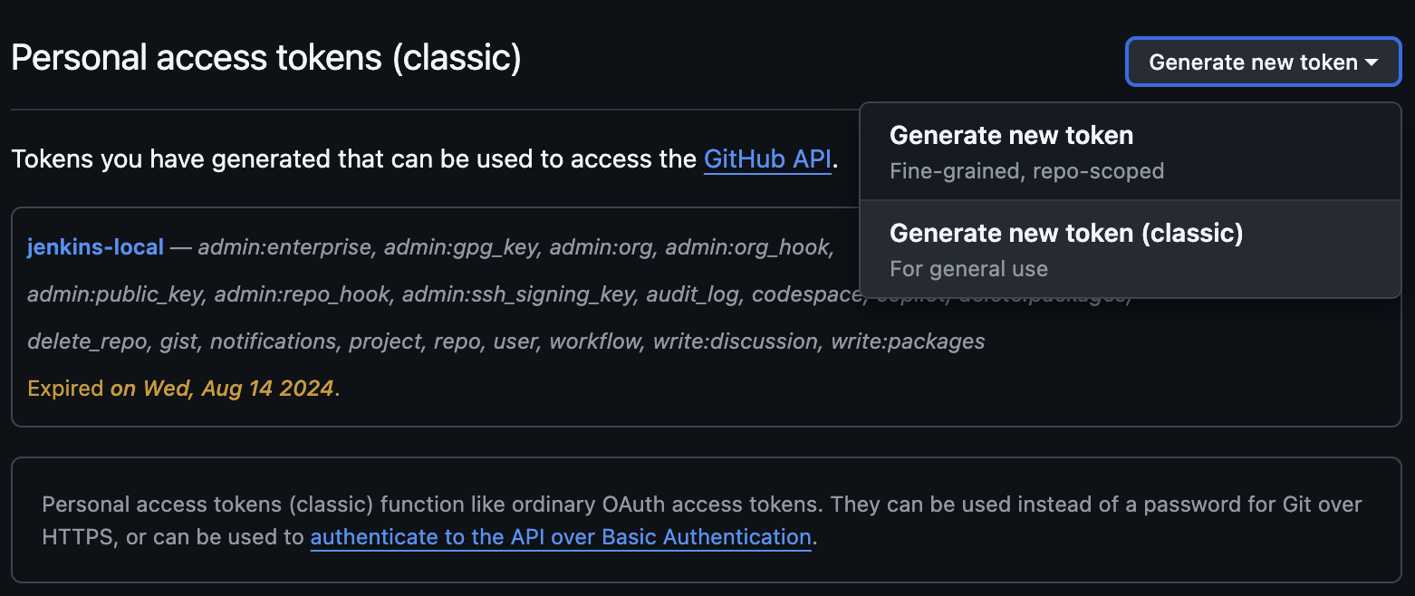

Git and GitHub Installation Guide
7. Setting for Personal Access Token
5

Slide 14
Git and GitHub Installation Guide
8. Push code to github
Username: User Github
Password: Acces Token
5

Slide 15
GIT
New Project
Git is a free and open source distributed version control system. Git can track changes in source code for developers to work together.
Github is a cloud hosting service that evolved from Git.
3

Slide 16
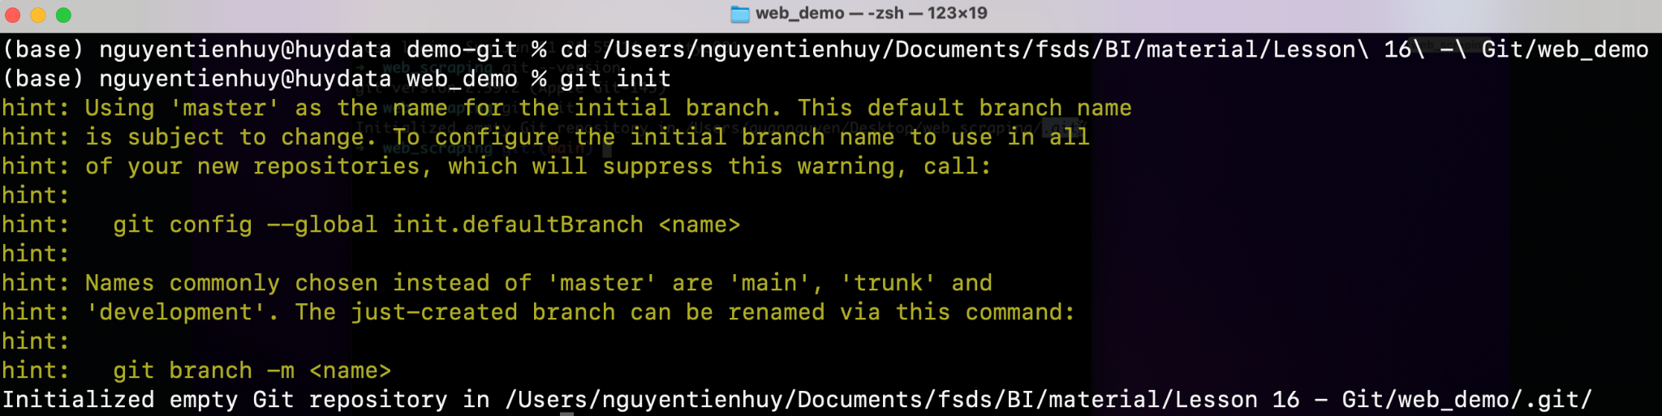
Git for New Project
1. Init Git - New Project
5

Slide 17
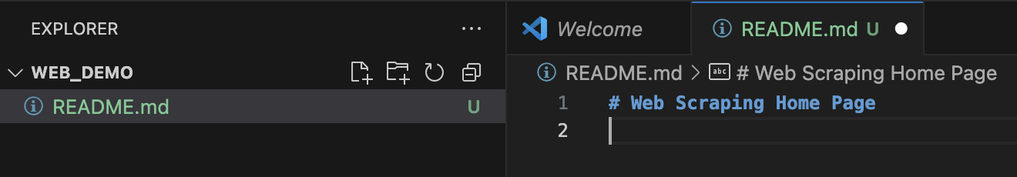
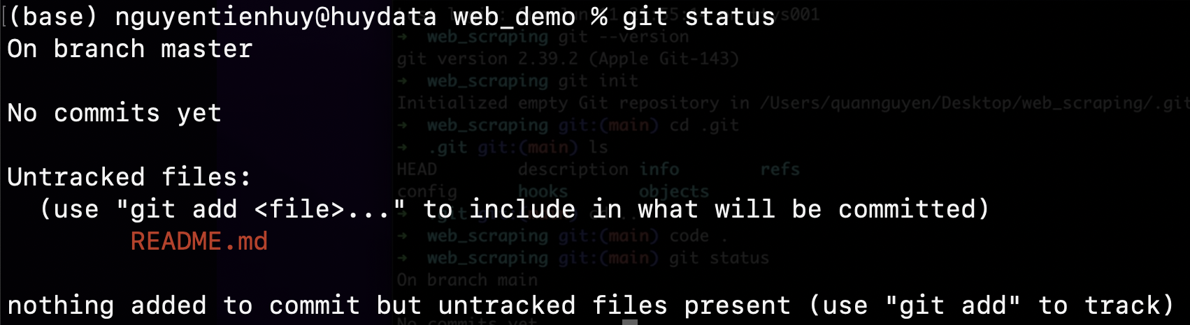
Git for New Project
2. Code
Untracked
5

Slide 18
Git for New Project
3. Track files
Untracked
5

Slide 19
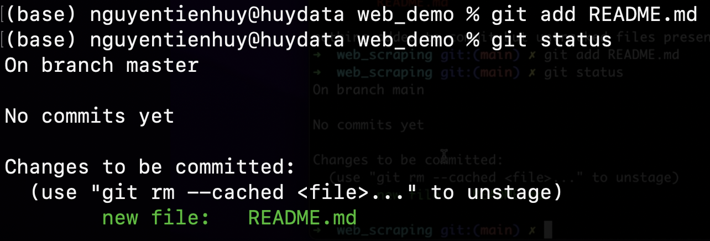
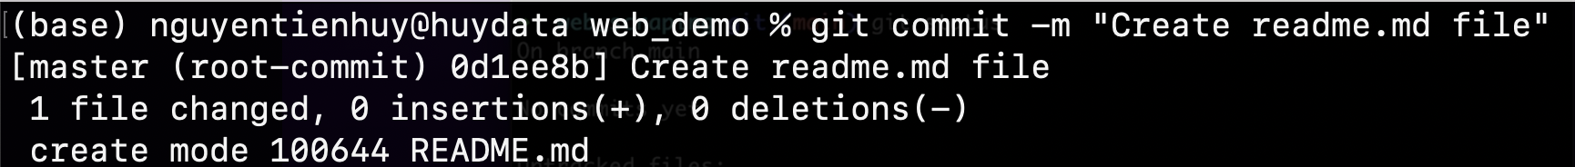
Git for New Project
3. Track files
5

Slide 20
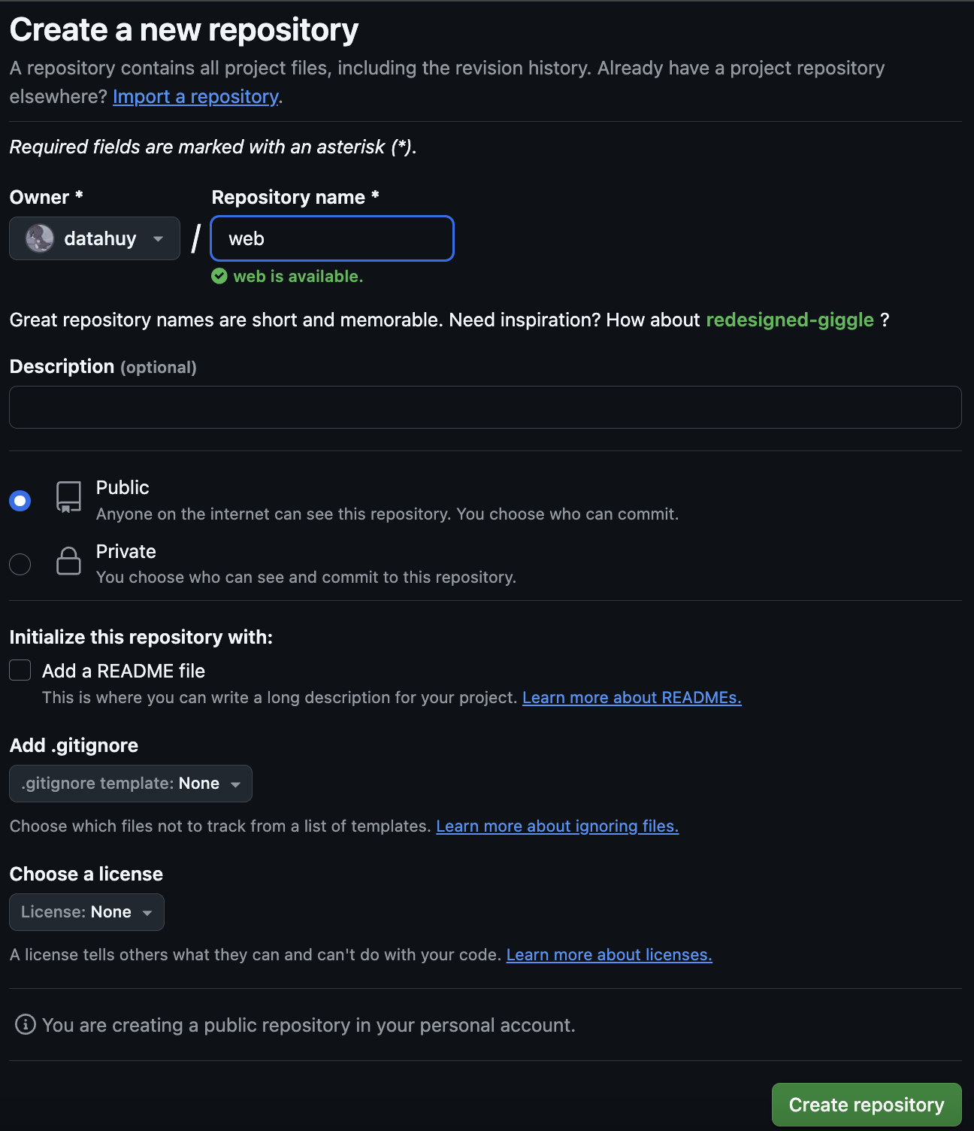
Git for New Project
4. Create new Github repo
5

Slide 21
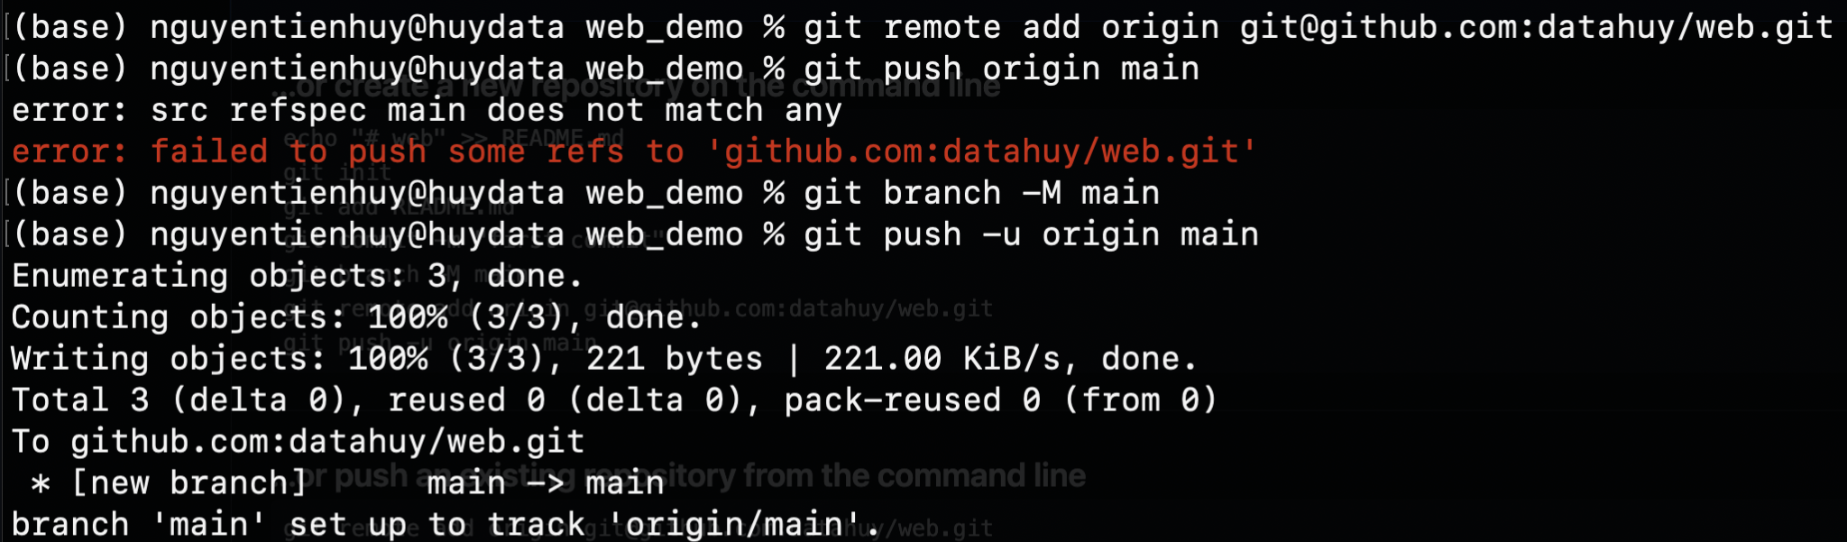
Git for New Project
4. Create new Github repo
5

Slide 22
PRACTICES
Add folder Code Titanic to Github
4

Slide 23
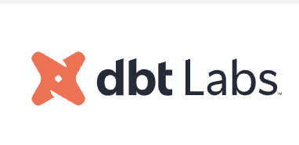
DBT
dbt is the industry standard for data transformation.
Transform raw data into analysis-ready insights, and make data-driven decisions with confidence.
3

Slide 24
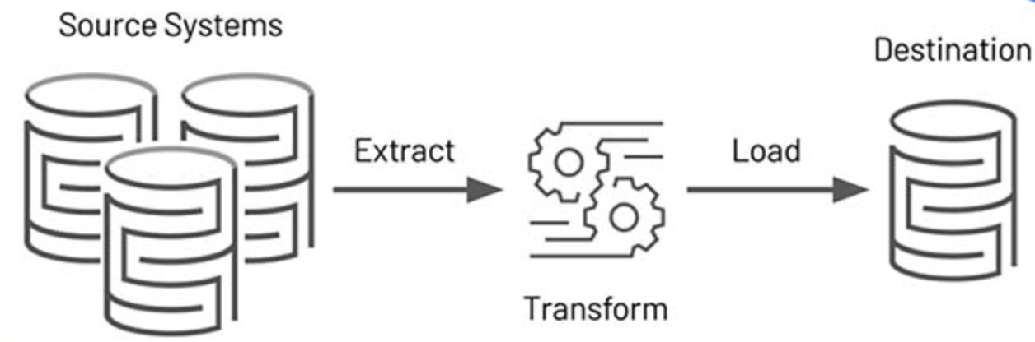
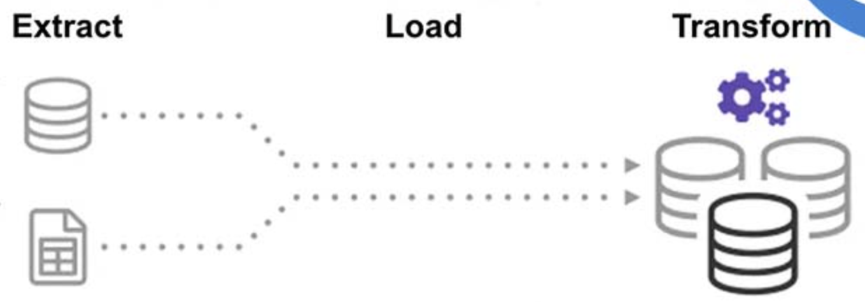
ETL vs ELT
ETL
ELT

Slide 25
DBT vs SQL
SQL Thủ Công | DBT
Viết query để lấy kết quả | Viết model có version control
Tự quản lý dependencies | Tự động lineage dependencies
Tự viết ETL thủ công | ETL tổ chức chuẩn như code
Không có test/QA | Có test data tự động
Không có tài liệu sống | Auto-documentation
Khó scale khi phức tạp | Scale tốt khi pipeline lớn
4

Slide 26
DBT vs SQL
We are asked by the marketing team to create a denormalized table customer_orders, with information about every order placed by the customers. Let’s assume the customers (DimCustomer) and orders data (FactInternetSales) are loaded into the warehouse by a process.
1/ SQL
2/ DBT
4

Slide 27
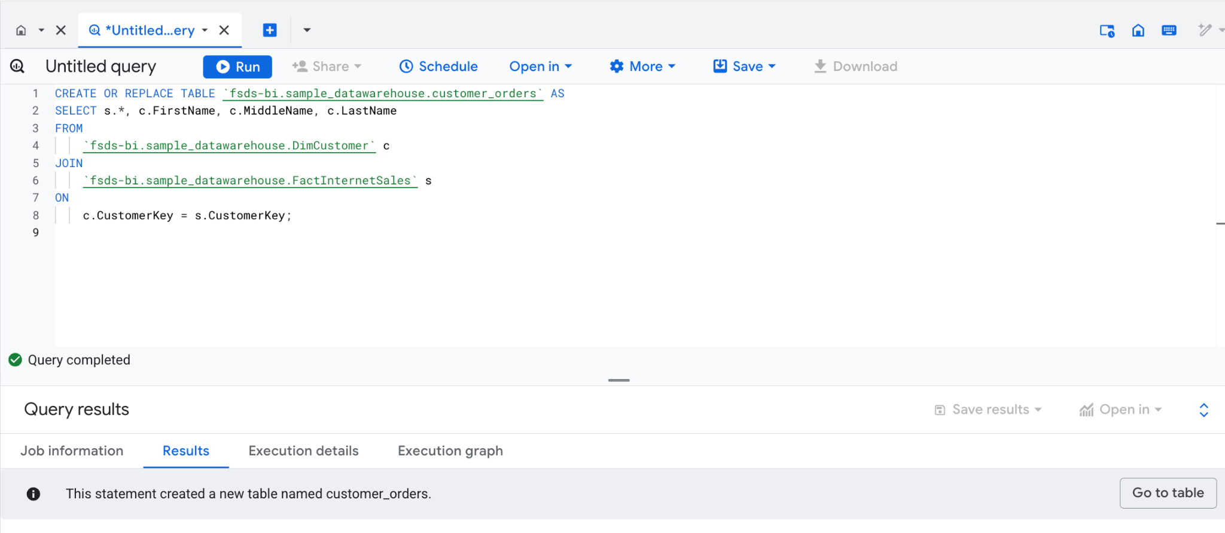
SQL
4

Slide 28
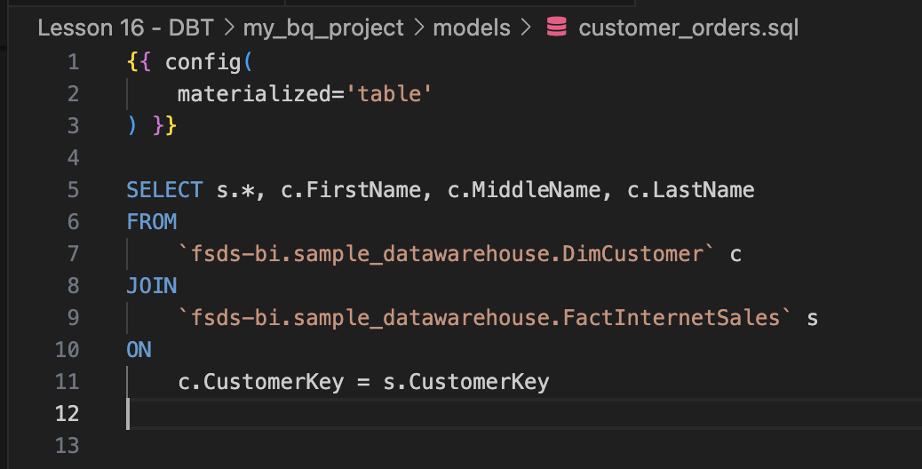
DBT
dbt run --select customer_orders
4

Slide 29
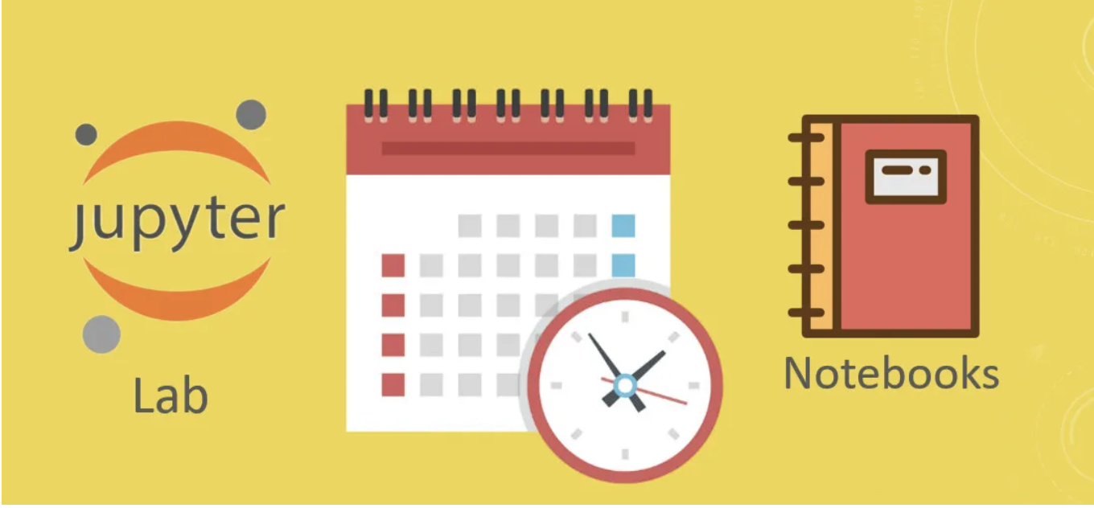
Jupyter Lab
Scheduler
3

Slide 30

fullstackdatascience.com
References
https://git-scm.com/
11

Slide 31





Thank you
096 574 90 25
CREATED BY
Nguyen Tien Huy
info@robusto.ai
fullstackdatascience
huynt@fullstackdatascience.com
Data Manager
https://fullstackdatascience.com/
Hanoi, Vietnam

